Slide 1

IPL Analysis (2021-2023)
The Indian Premier League (IPL), also known as the TATA IPL for sponsorship reasons, is a men's Twenty20 (T20) cricket league held annually in India. Founded by the BCCI in 2007, the league features ten city-based franchise teams.
It is 20 overs format , inaugurated in the year 2008.
After the group stage, the top four teams advance to the playoffs, which include Qualifier 1, Eliminator, Qualifier 2, and the Final.
Currently, there are 10 teams in the IPL.
IPL attracts top cricketing talent from around the world.
Teams consist of both domestic and international players, with a maximum of four foreign players allowed in the playing XI..
Players are bought and sold through an annual auction system.
Franchise owners bid for players to build their teams before each season.
By Rohan Gollar

Slide 2







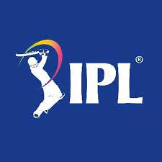




Teams

Slide 3
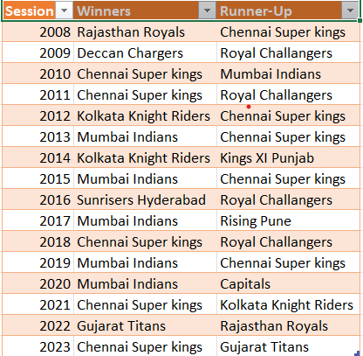
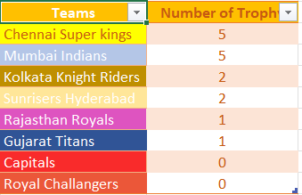
Year By Winners
Team with number of Titles

Slide 4
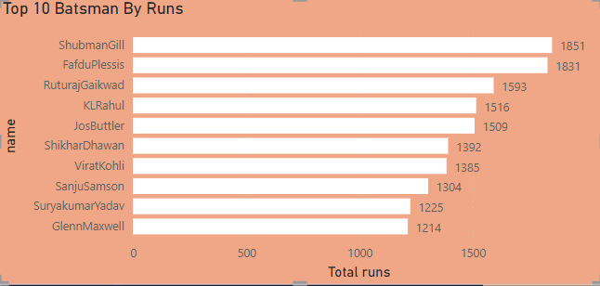
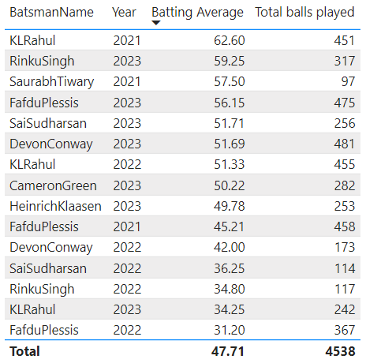
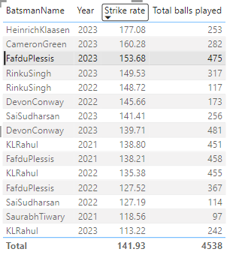
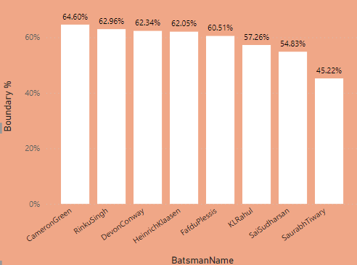
Batting Analysis
Top 10 Batsman By runs ( 2021-2023)
Top Batsmans By Average 2021-2023
Top Batsman by strike rate 2021-2023
Top Batsman by Boundary % 2021-2023

Slide 5
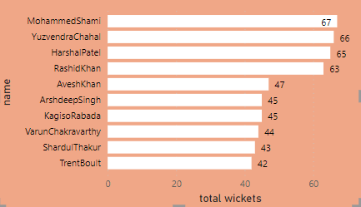
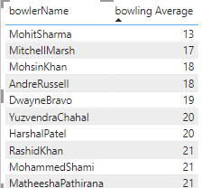
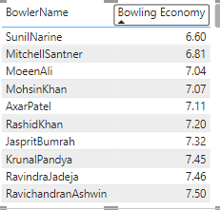
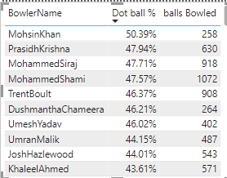
Bowling Analysis
Top wicket takers 2021-2023
Top bowlers by bowling Average
Top Bowlers by Economy
Top Bowlers by Dot Ball Percentage

Slide 6
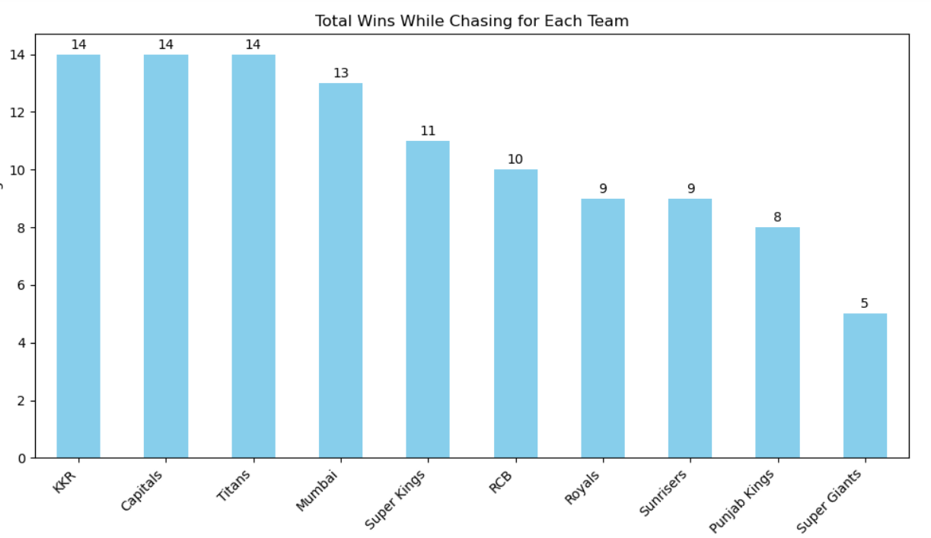
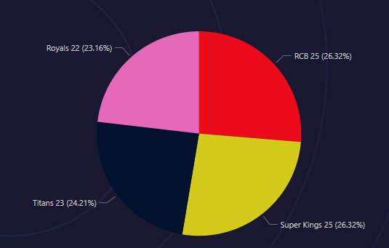
Team Analysis
Numbers of wins while Chasing score
Top 4 teams by Number of Wins
KKR,Capitals,Titans have won 14 matches while Chasing Score
RCB and CSK lead with 25 wins each, followed by Titans with 23 and Royals with 22

Slide 7
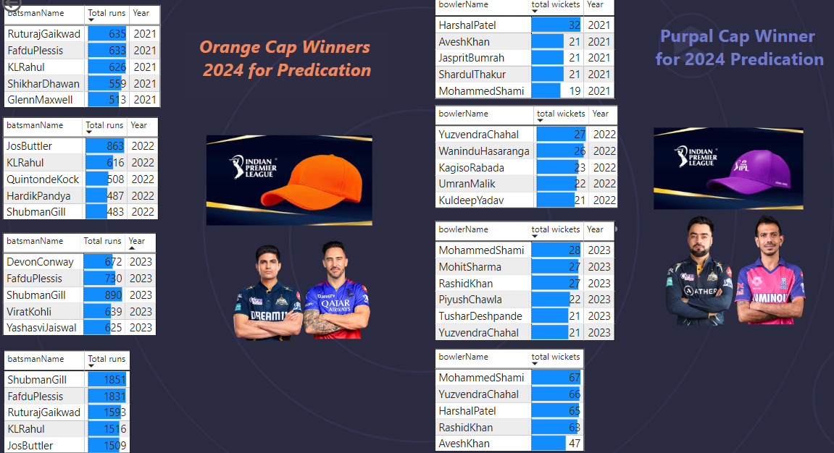

Slide 8


Top 4 teams for 2024 predication
Winner
Runner-Up

Slide 9
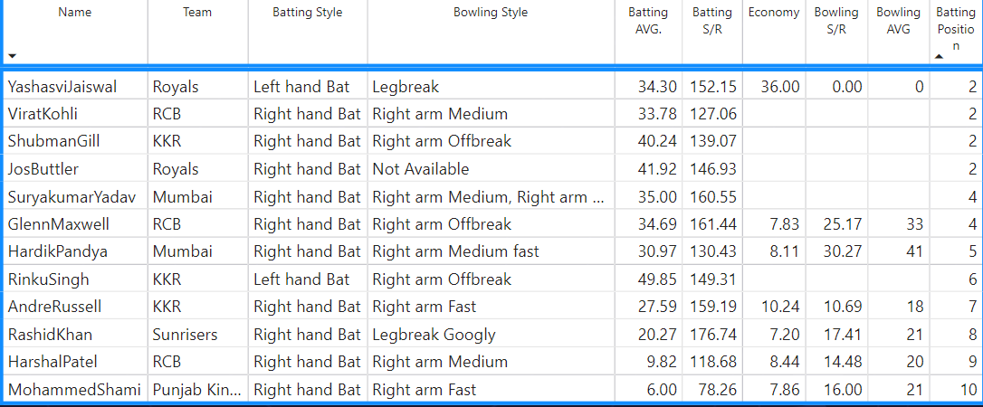

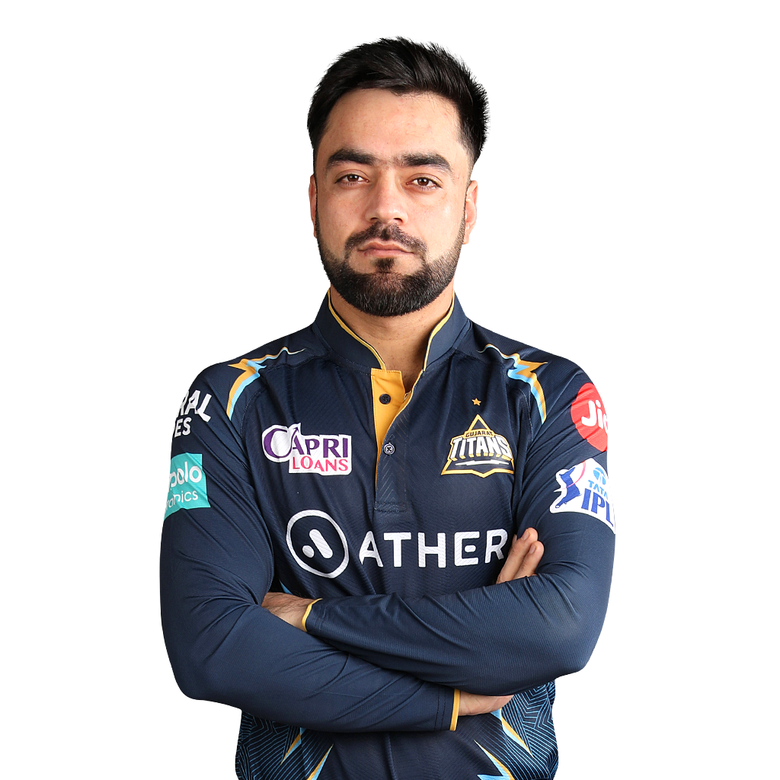

Best Eleven
Three Best All Rounders
THANK YOU…
Andre Russell
Rashid Khan
Hardik Pandya

